Slide 1
A8: Insecure Deserialization
Dylan Rowley - 15439382
Cian Kelly - 15386256
Michael Kehoe - 15703545

Slide 2
introduction
Overview
OWASP
Real Life Examples
Mitigation
Conclusion

Slide 3
Overview
Serialization & Deserialization
Insecure Deserialization
Serialization/Deserialization in action

Slide 4
A8:2017 – Insecure Deserialization
Serialization: Converting an object into a format so that it can be stored, transmitted and/or reconstructed later.
Deserialization: Reconstructing the object from the serialized data.

Slide 5
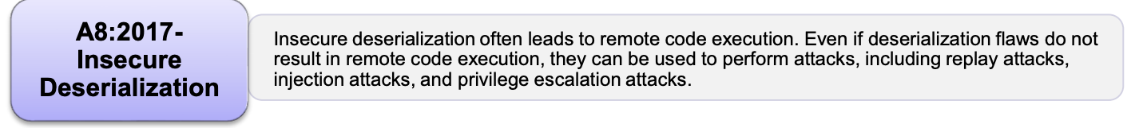
A8:2017 – Insecure Deserialization
Insecure Deserialization: The deserialization mechanism is repurposed for a malicious effect.
Many programming languages allow native, customizable serialization processes
The deserialization may allow for some code to be executed before the untrusted data can be verified

Slide 6
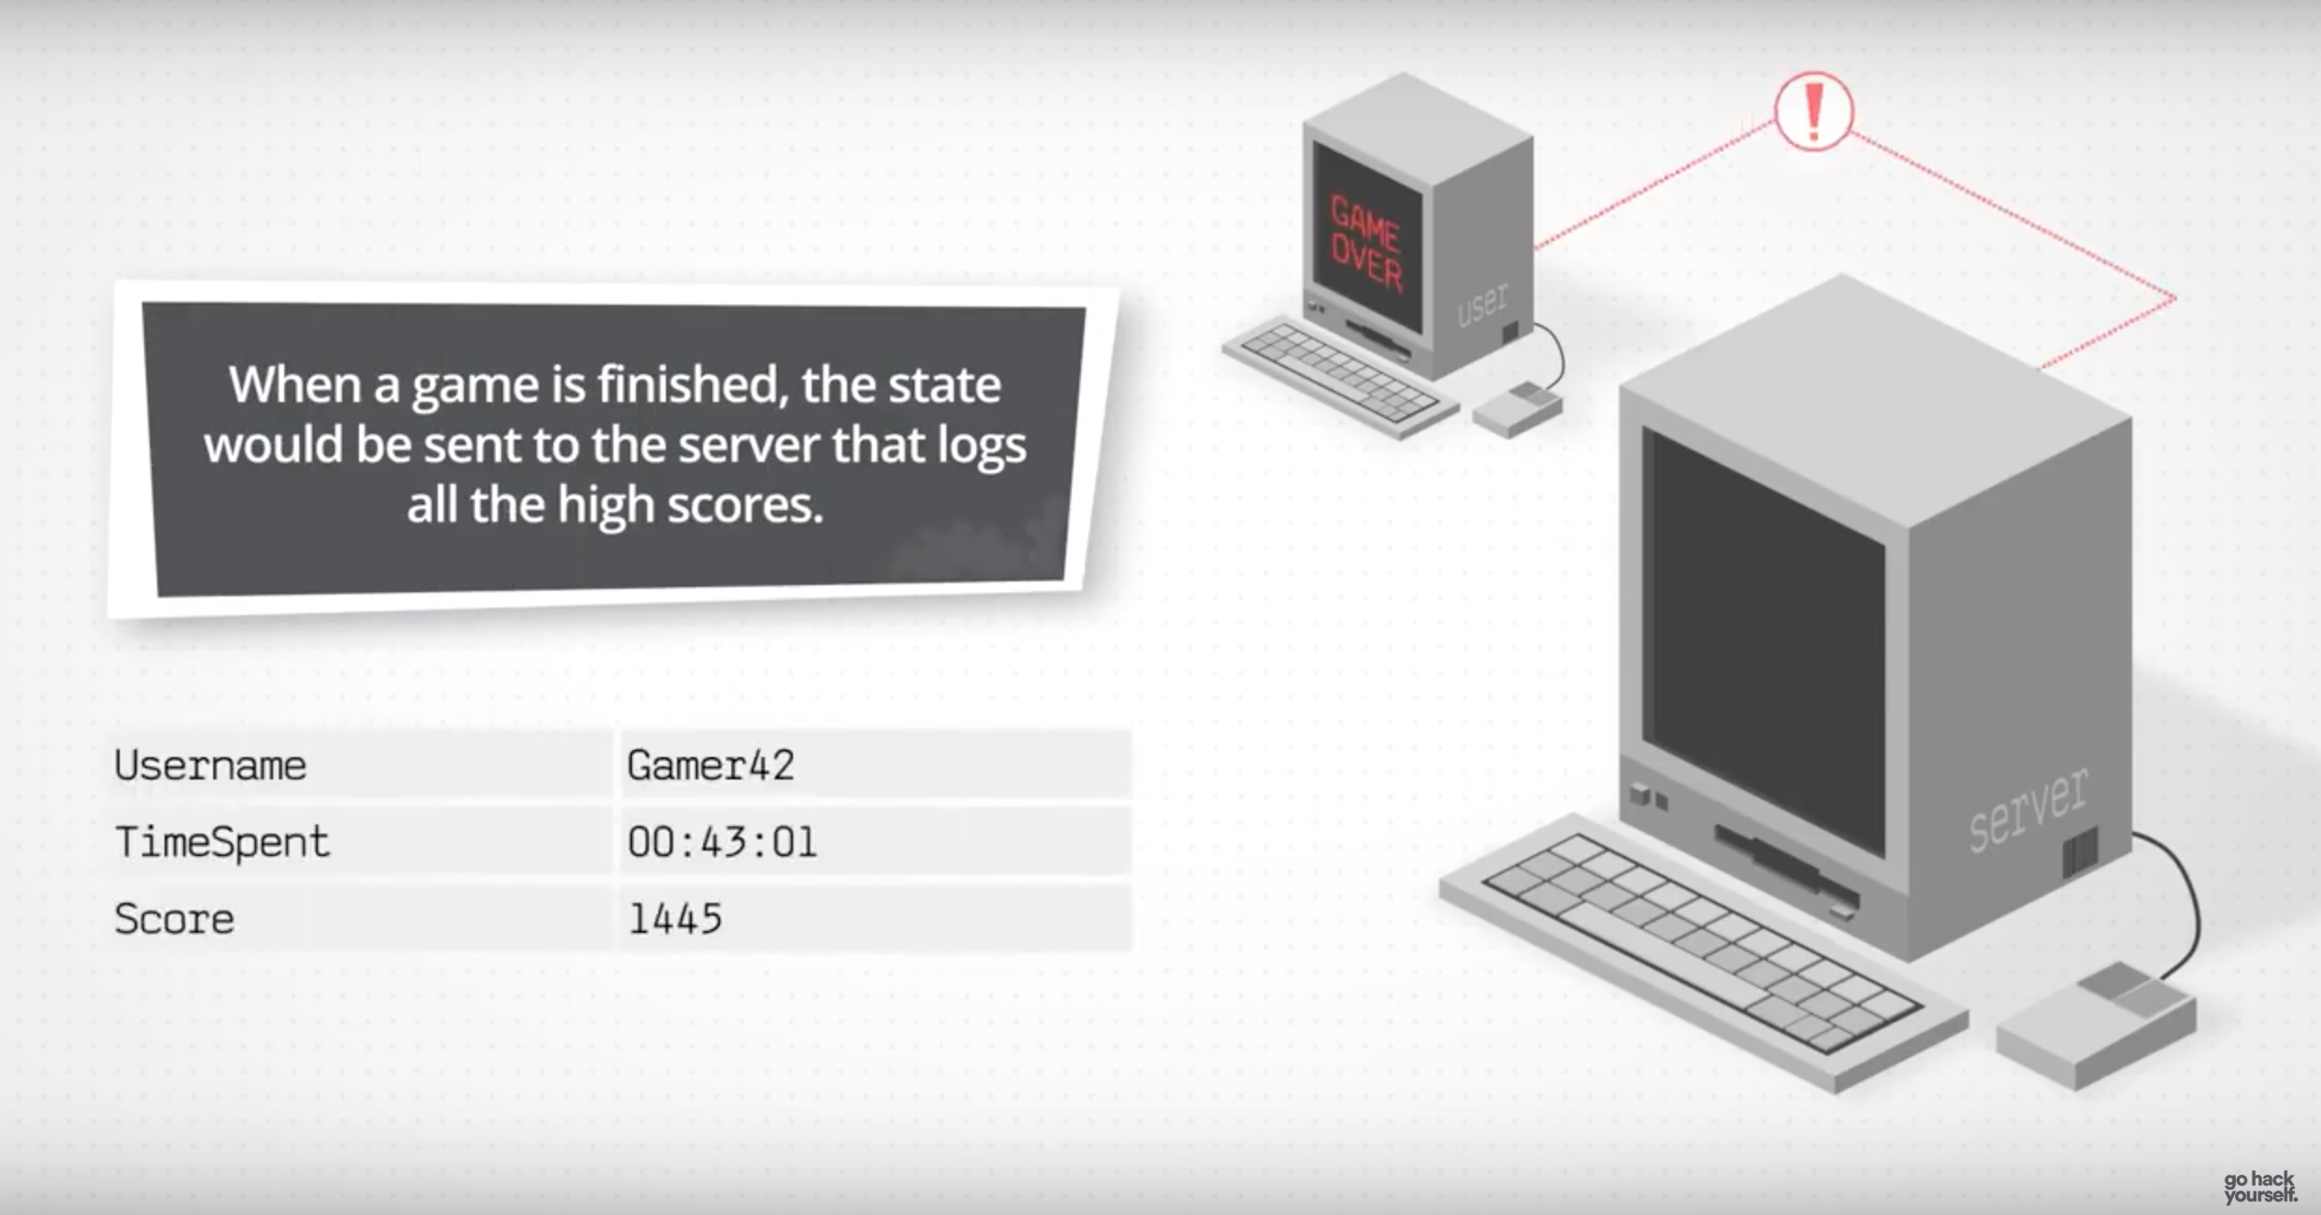

Slide 7
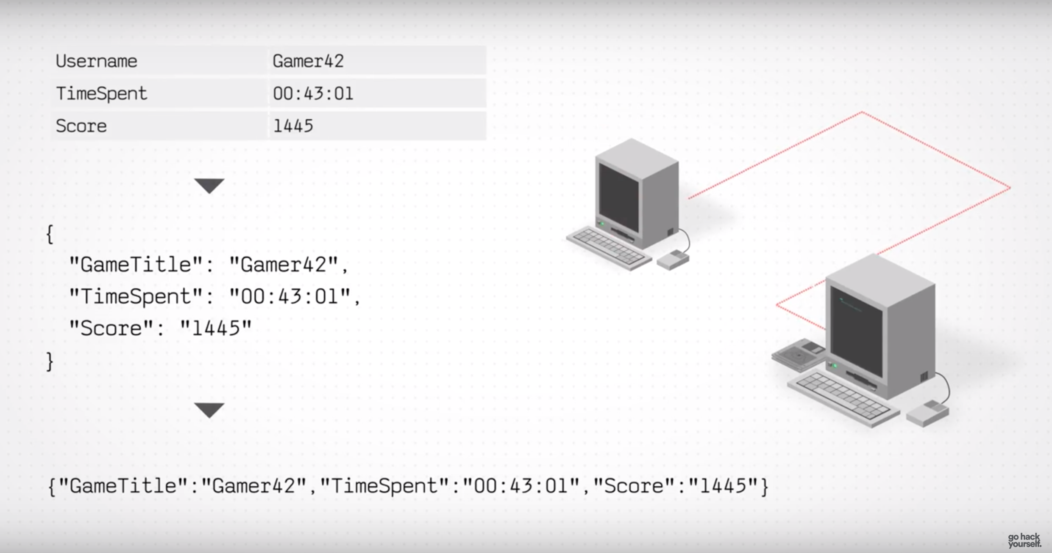

Slide 8
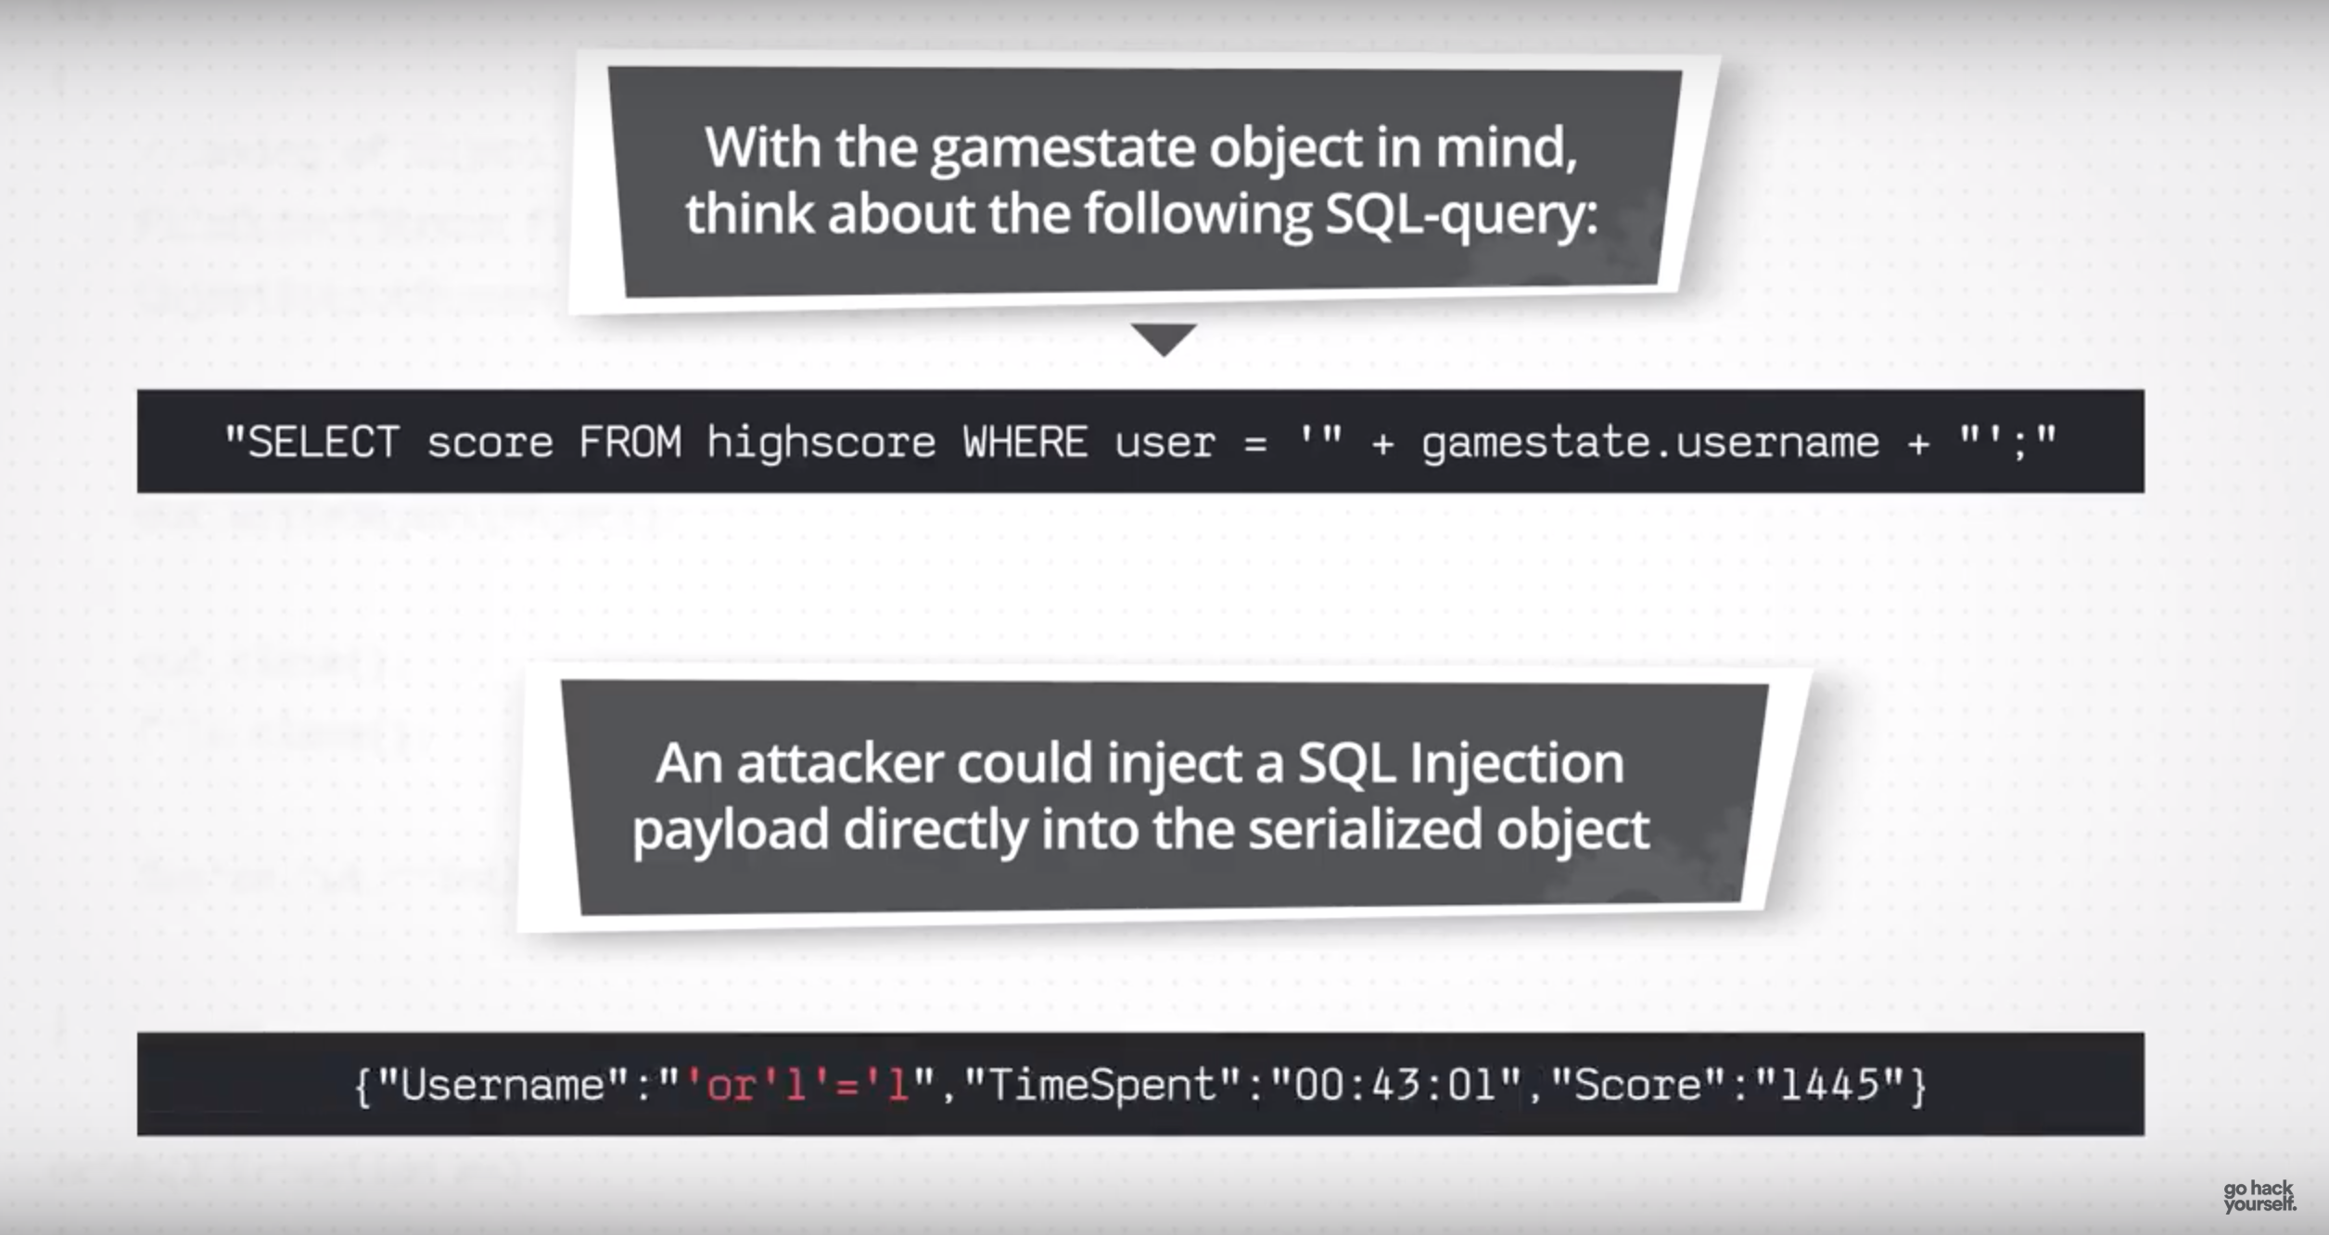

Slide 9


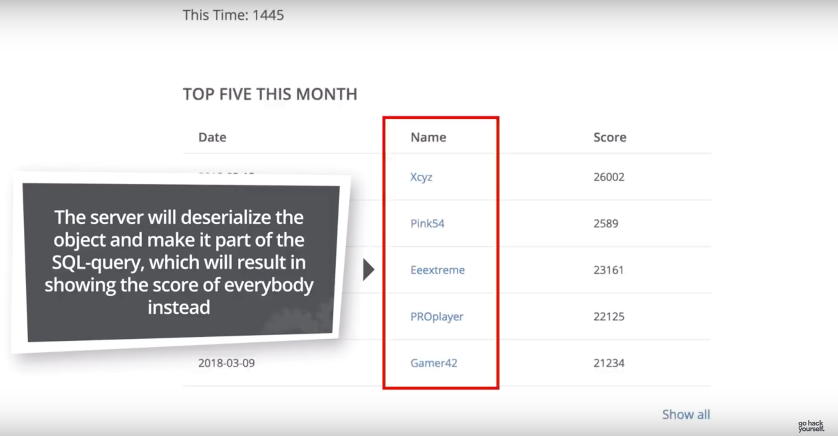

Slide 10
OWASP
Attack Vector
Security Weakness
Impacts

Slide 11
Exploitability
Insecure Deserialization is very difficult to exploit:
Serialization and deserialization vary greatly depending on the programming language
Different serialization formats
Off the shelf exploits rarely work without further tweaking

Slide 12
Prevalence & Detectability
Prevalence:
Developers know to sanitize user input as it may contain anyting.
But, as serialized data is handled as an object, it is often forgotten.
Detectability:
Automated tools now exist to detect Insecure Deserialization Exploits
Java-Deserialization Scanner, a plugin for Burp Suite

Slide 13
Technical Impact
Remote Code Execution can lead to:
Authentication Bypasses.
Loss of Integrity: Corruption and/or loss of data.
Loss of Confidentiality: Exposing the data to unauthorized parties.
Loss of availability: Denial Of Service.

Slide 14
Real Life Examples
PayPal (2016)
matrix.org/riot.im (2019)

Slide 15
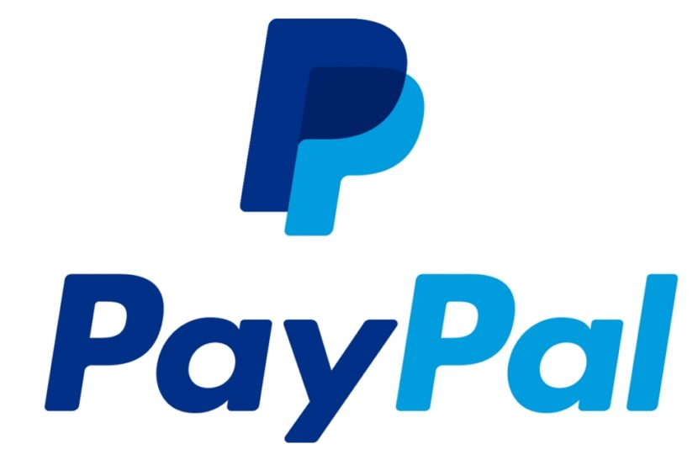

Attacks in 2016
Popularity of JSON
Used by PayPal, WordPress and San Francisco Metropolitan Transit Agency (SFMTA)
Were all vulnerable in 2016
Able to execute shell commands from manger.paypal.com and open backdoors on PayPal servers
https://threatpost.com/java-serialization-bug-crops-up-at-paypal/116054/

Slide 16
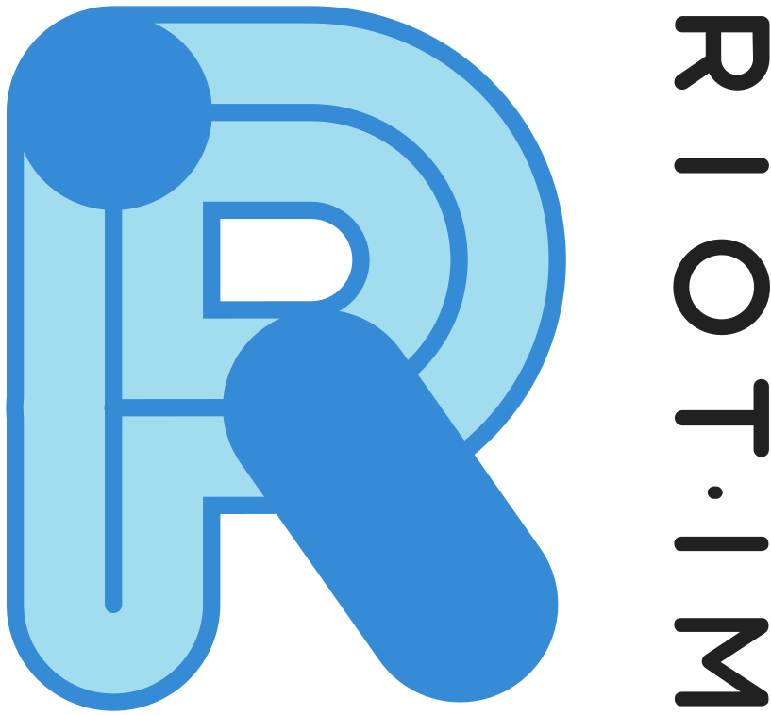
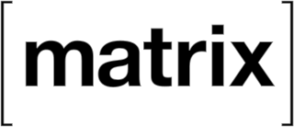
Recent Attacks
Most recent attack was on matrix.org/riot.im infrastructure (April 11 2019)
Jenkins facing internet using SSH
Able to inject own key to host
Took 3-5 days to clean and update services (update software, reconfigure servers and signed signatures programs)
https://twitter.com/matrixdotorg/status/1116304867683905537

Slide 17

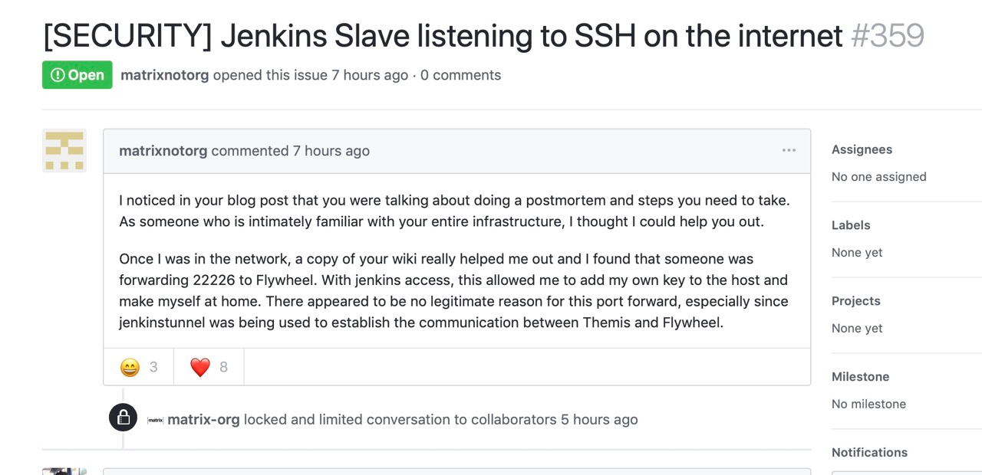
https://github.com/matrix-org/matrix.org/issues/371

Slide 18
Mitigation
Methods to prevent insecure deserialization:
Serialization Process
Application Input
Other

Slide 19
The vulnerability takes many different forms, so there are multiple attack angles that the hostile intruder can take
This means that a lot of the advice given to developers and security experts can sound somewhat generalized
Specific functions within a web application will need to be scrutinized closely if there are any concerns that this vulnerability could affect one of your live systems

Slide 20
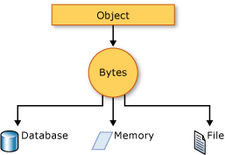
Serialization process
Encrypt Serialization Process
Stops hostile object creation
Stops data tampering
Require large-scale application changes
Monitor Serialization Process
Catches any malicious code
Catches any breach attempts

Slide 21
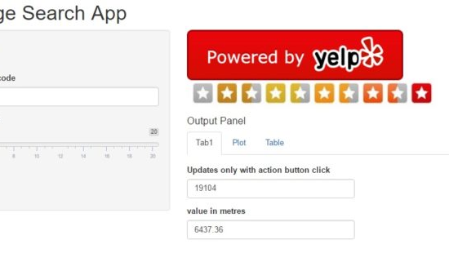
Application input
Validate user input
Stops privilege escalation
Attackers can launch DDOS & remote execution from input
Strengthen user input
Make unauthorized code difficult to run
Allow only a designated class to deserialize

Slide 22

Other possible mitigation techniques
Limited Access Permissions
If hostile object tries to initiate system process/resource will be denied access and a permission flag will be raised (makes system admin aware)
Signed Data
Bypasses any data that has not been digitally signed
Ignores data without a valid signature
Flagging will allow analyzation of any recent app activity
Notes:
Permission, will be flagged and the system admin can then check for malicious code or intent
A virtual handshake within the application

Slide 23
Mitigation observations
Plugging these holes will require human intervention and manual code scrubbing and can be quite labour-intensive
Not all of these solutions can be implemented in every scenario but, with enough awareness of the issue, you can start to formulate a strategy that will protect your web app from malicious activity from the internet
Notes:
Difficult to mitigate
Not one fix for all

Slide 24
Conclusions
Serialization is common across many programming languages
Due to its prevalence the CVSS score is most often critical
A vulnerability in Java used by Cisco Secure Access Control System (ACS) had a 9.8 score
Notes:
Serialized so can be saved in a format e.g. XML
JSON more popular means this vulnerability is more popular

Slide 25
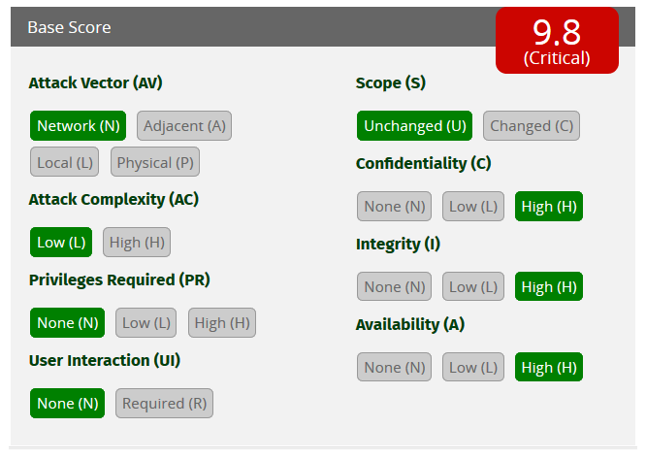
ACS 5.8
Notes:
As shown is critical
Coders trust serialisation, this is what is abused
First point of attack, can lead to DDOS, remote access control, etc.

